Slide 1
Subject Name :DATABASE MANAGEMENT SYSTEMS Presentation Title: ARCHITECTURE OF HBASE
JEPPIAAR INSTITUTE OF TECHNOLOGY
“Self-Belief | Self Discipline | Self Respect”
Department of Computer Science and Engineering
Team Members:
Students Name Reg.No:
1.JULIE CHRISTINA.J 210618104021
2.GEETHANJALI.R 210618104013
3.KAVYA.M 210618104023
4.KAVIYA.O 210618104025
5.BIBILIN MANUELA.E 210618104009
6.KERTHIKA.K 210618104025

Slide 2
Objective
To Design/ Analyze/ Evaluate
HBase can handle large data sets (millions or billions or rows and columns) and provide fast, random and real time, read and write access over the data.
HBase also stores the versions of data.

Slide 3
Technical Details
What is HBase architecture?
HBase - Architecture. Advertisements. In HBase, tables are split into regions and are served by the region servers. Regions are vertically divided by column families into “Stores”. Stores are saved as files in HDFS.
HBase Read and Write Data Explained
The main reason for using Memstore is to store data in a Distributed file system based on Row Key
How does HBase work?
HBase is a data model similar to Google's big table that is designed to provide random access to high volume of structured or unstructured data.

Slide 4
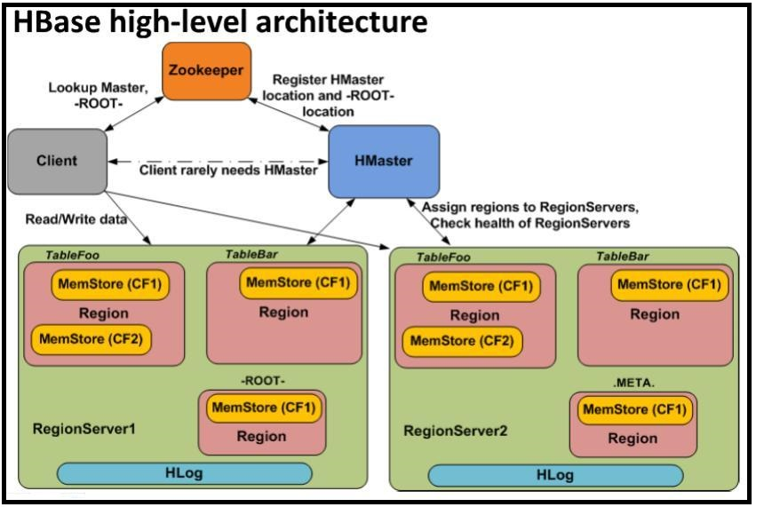
Block Diagram/ Work Flow/ Flow Chart

Slide 5
Technical Details
HOW HBASE RELATED TO DBMS:
HBase is a column-oriented non-relational database management system that runs on top of Hadoop Distributed File System (HDFS).
The important topics in this HBase architecture blog are:
HBase Data Model
HBase Architecture and it’s Components
HBase Write Mechanism
HBase Read Mechanism
HBase Performance Optimization Mechanisms

Slide 6
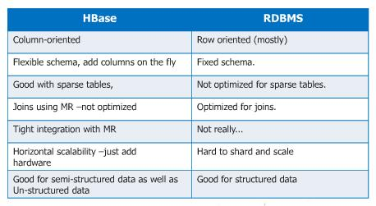
Technical Details
Difference between HBase and RBMS

Slide 7
Technical Details
the latest version of hbase is Apache HBase 0.98.0 is released

Slide 8
Technical Details
ADVANTAGES OF HBASE:
It can handle very large volumes of data
Very flexible on schema design/no fixed schema
Simple client interface
License free
Auto failover

Slide 9
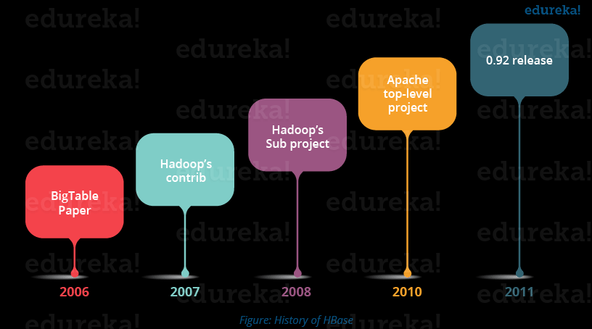
Technical Details
HISTORY OF HBASE
Apache HBase began as a project by the company Powerset for Natural Language Search, which was handling massive and sparse data sets.
Apache HBase was first released in February 2007.
Later in January 2008, HBase became a sub project of Apache Hadoop. In 2010, HBase became Apache's top level project.

Slide 10
Result & Discussion
Since 1970, RDBMS is the solution for data storage and maintenance related problems. After the advent of big data, companies realized the benefit of processing big data and started opting for solutions like Hadoop.
Hadoop can perform only batch processing, and data will be accessed only in a sequential manner.
To overcome this defect h base is implemented.

Slide 11
Future Scope
What is the Future of Hbase.
As we know that it is used in case of Real-Time scenario But so is Cassandra & MongoDB.
The only advantage HBase gets is that it comes along packaged with Cloudera / HDP distribution

Slide 12
Reference
^ a b c d e "Apache HBase – Apache HBase Downloads". Retrieved 7 September 2019.
^ Chang, et al. (2006). Bigtable: A Distributed Storage System for Structured Data
^ "Apache HBase – Powered By Apache HBase™". hbase.apache.org. Retrieved 8 April 2018.
^ a b "Migrating Messenger storage to optimize performance". www.facebook.com. Retrieved 5 July2018.
^ Facebook: Why our 'next-gen' comms ditched MySQL Retrieved: 17 December 2010

